Slide 1




Jail Ministry:
A Tree Planted by Living Waters
Gives Life!
Psalm One
Notes:
Opening Prayer if not already spoken. Read Psalm One with next two slides.

Slide 2
¹How blessed is the man who does not walk in the counsel of the wicked,
Nor stand in the path of sinners,
Nor sit in the seat of scoffers!
²But his delight is in the law of the LORD,
And in His law he meditates day and night.
³He will be like a tree firmly planted by streams of water,
Which yields its fruit in its season
And its leaf does not wither;
And in whatever he does, he prospers.

Slide 3
⁴The wicked are not so,
But they are like chaff which the wind drives away.
⁵Therefore the wicked will not stand in the judgment,
Nor sinners in the assembly of the righteous.
⁶For the LORD knows the way of the righteous,
But the way of the wicked will perish.
Psalm One
NASB

Slide 4
Human Beings Are Complex!
We are designed with a physical body, a human spirit and our mind, will and emotions; usually called our soul.
Non believers usually dwell on the physical aspects.
Believers usually dwell on the spiritual aspects.
The soul is intertwined with both!
The way our mind, will and emotions work is an important part of growing and maturing.

Slide 5
Complexity!
1) Spiritual Picture
2) Maturity Development Picture
3) Common Relationship Dysfunction Picture
I am equipping today in three parts.
Notes:
It helps to know whether something we are dealing with is a spiritual issue or a maturity one.
This will have an impact on the quality of all relationship interactions and your determination as to how to handle situations.
I will stop for questions after each part before we go on to build on the next.

Slide 6
The Spiritual Picture of Messiah, Men & Trees
Part 1

Slide 7
Many References to men as “trees”
The righteous man will flourish like the palm tree,
He will grow like a cedar in Lebanon.
Psalm 92:12 NASB
I have seen a wicked, violent man spreading himself like a luxuriant tree in its native soil.
Psalm 37:35 NASB
The fruit of the righteous is a tree of life,
And he who is wise wins souls.
Proverbs 11:30 NASB
The womb forgets them, the worm feasts on them; evil men are no longer remembered but are broken like a tree.
Job 24:20 NASB

Slide 8
Trees, Counsel & Judgment
Two trees in the Garden of Eden
Abraham & angels under Oak of Mamre
Deborah under Palm Tree
King Saul under Pomegranate Tree
Messiah on a tree yet He is THE Tree of Life!
And if a man have committed a sin worthy of death, and he be to be put to death, and thou hang him on a tree:
Deuteronomy 21:22 KJV
Notes:
You will think of more examples; And there is a study on men and trees on our SAM website.

Slide 9
Trees and Counsel/Judgment
Etz
Etzah
This is the Hebrew word translated as
“Tree” in Scripture.
It comes from the firmness and straightness of a tree,
as in an elder in a tribe.
This is the Hebrew word translated as “counsel.”
It can be wise or unwise counsel,
just as a tree can be straight and firm, or gnarled.
Notes:
Do you remember which day of Creation trees were made? The Third Day

Slide 10

Our Messiah Jesus of Nazareth!
The Rod, Staff or Branch of Jesse
Notes:
Our Great Shepherd; and Shepherds have staffs or rods; usually wood.
Words for Rod and Staff in Hebrew show connections to both trees and judgment, authority or ruling. Which day was our Messiah raised up? The third day!
The final day, Messiah on His return will have a rod of iron; an entirely different picture!

Slide 11
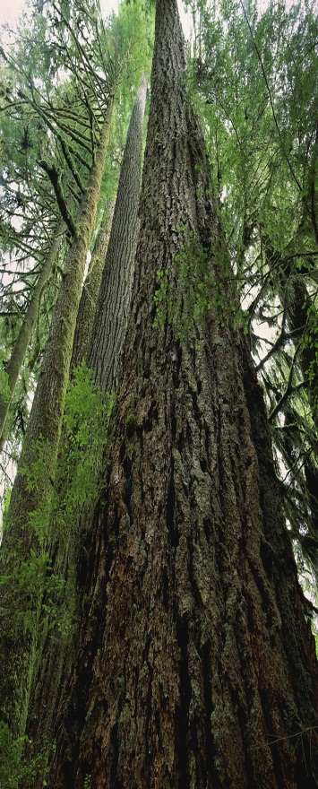
Our Messiah Jesus of Nazareth!
The Servant Shepherd, yet the Elder Who gives Wise Counsel
Because the 7 Spirits of God Rest on Him
7 Fold Spirit of God-Isa. 11:1-2; Rev. 1:4, 3:1, 4:5, 5:6
Counsel Might
Understanding Knowledge
Wisdom Fear
Holy Spirit
Notes:
If we start with wisdom, we end with fear….but Fear of God is the beginning of……wisdom. Fear as in awe/reverence
All from the Central Governing Spirit; our Father God! All of one piece, like the golden lampstand.
THIS is the tree we want to eat from and grow in! Growth cycles annually, around and around!

Slide 12

Messiah, the Branch, the Rod,
THE TREE of LIFE
Counsel Might
Understanding
Wisdom
Knowledge
Fear
Holy Spirit
Concentrating on the First Three Today
Wisdom leads to understanding which builds together into wise counsel!
Notes:
Concentrating on the first three today;
Wisdom leads to understanding which builds together into wise counsel!

Slide 13
Opposition Arises!
Proverbs 6: 16-19
Grouping Also seen in Romans 1:21-32
Haughty Eyes
Feet that
run to evil
Mouth giving
False witness
Lying Tongue
Hands that shed
Innocent Blood
Spreading Strife
Among brothers
Heart that devises Wicked plans
“Unsubmitted flesh-mind, will, emotions”
Ultimately given over to a darkened heart/character
Notes:
Does it surprise us that the kind of opposition that arises is presented in a group of seven as well?
HAUGHTINESS, n. The quality of being haughty; pride mingled with some degree of contempt for others; arrogance. Haughtiness is a form of pride as well.
Isa 2:11 The lofty looks of man shall be humbled, and the haughtiness of men shall be bowed down, and the LORD alone shall be exalted in that day.
When you look up scriptures referring to haughtiness it always refers to those who are rebellious against God and His Ways and contempt for His people.
Jer 48:29 We have heard the pride of Moab, (he is exceeding proud) his loftiness, and his arrogancy, and his pride, and the haughtiness of his heart.
Pro 8:13 The fear of the LORD is to hate evil: pride, and arrogancy, and the evil way, and the froward mouth, do I hate.
Pro 11:2 When pride cometh, then cometh shame: but with the lowly is wisdom.
Pro 13:10 Only by pride cometh contention: but with the well advised is wisdom.
Pro 14:3 In the mouth of the foolish is a rod of pride: but the lips of the wise shall preserve them.
Pro 16:18 Pride goeth before destruction, and an haughty spirit before a fall.

Slide 14
Watch for these Battles
Wisdom | Understanding | Counsel | Holy Spirit | Might | Knowledge | Fear/ Awe
Will | Often | Find | Trouble | From | These | Things:
Haughty Eyes (Pride) | Lying Tongues | Hands That Shed Blood | Hearts Devise Wicked plans | Feet Run To evil | Bearing False Witness | Spreading Strife Among brothers
Notes:
Trouble meaning opposition.
The spirit we listen to affects our character and behavior. These types of troubles usually mean spiritual issues, not just immaturity.

Slide 15
Walking in Righteousness or not?
Clearly, the people we serve are those who have made mistakes; some more serious than others.
Some have never had the wise counsel of an elder to help them shape their lives.
Some refused to listen to wise counsel from anyone…until now.
Peter Galowski, of Changed Heart Ministries, refers to those who aren’t serious about making positive change as “knuckleheads.” Says he was one, once!

Slide 16
Motives? (“Knuckleheads” or not)
How often must we sort out which people were charged unfairly, and which just wish it was that way?
Long enough time with one person?
What do we look for when in that process of making acquaintance and assessment?
Do we always make the right call?
Notes:
Responses written on dry erase board Sorting Often/ Rarely
Enough time? Often/Rarely
Criteria? Clear/unclear
Right Call made? Often/rarely

Slide 17
Err on the side of Grace
Behold! I send you out as sheep in the midst of wolves. Be ye therefore, wise as serpents and harmless as doves.
Matthew 10:16 KJV
Serpents? Doves?
A “healthy suspicion” is wise to cultivate, yet without becoming cynical and doubting everyone.
Spiritual or maturity issues?
What criteria are helpful in the process?
Notes:
Serpent: Ophis Strong's 3789 (Ah-fece) for sharpness of vision 1) to look at, behold
2) to allow one's self to be seen, to appear
Doves peristerah Strong's 4058 dove, pigeon; apparent harmlessness
Questions on Part 1 Spiritual Picture?

Slide 18
Maturity Development Picture
Part 2
The Life Model: Living from the Heart Jesus Gave You
Notes:
Questions before we go on to Part 2?

Slide 19

 | The Life Model is a unifying approach to ministries of counseling, recovery, pastoral care, prayer ministry, deliverance, inner healing, child rearing, body life and health.
Notes:
Grateful thanks to E. James Wilder, PhD and the staff of Shepherd’s House who have given their blessing to our use and development of this material.

Slide 20

Bringing the Life Model to Life (Study Guide)
The healing, growth and ministry workbook to accompany the Life Model book "Living from the Heart Jesus Gave You

Slide 21

 | How God designed men to grow and mature. This is the most complete description of Life Model maturity in print. Includes: Stages of Infant, Child, Adult, Parent, and Elder How to seek out corrective help... | :

Slide 22
The Life Model
Stages and Challenges for Individuals, Families and Communities
Notes:
SAM is a Life Model equipping community. Attempting to help people mature in every way needed.

Slide 23
Infant: Birth through Age 3
Primary Task: Learning to Receive
Personal Tasks | Family/Community Tasks | When Tasks Fail
Live in Joy; Expand joy capacity, Build joy strength | Parents delight in child’s unique wonderful existence | Weak identity; fear & coldness dominate Bonds with others
Develop trust | Parents build strong unconditional love bonds with infant | Difficulty bonding: leads to manipulative, self-centered, isolated, discontent
Learns how to receive | Gives care that matches infants needs without infant asking | Is withdrawn, disengaged, self-stimulating, unresponsive
Begins to organize self into a person through relationships | Attention to true characteristics of infant | Has an inability to regulate emotions
Learns how to return to joy from every unpleasant situation | Provides safety and companionship to help return to joy | Uncontrollable emotional outbursts, Avoidance, stuck
Notes:
Primary resulting problem in adult life when tasks fail: weak and stormy relationships

Slide 24
The Child Stage: age 4 through12
Primary Task: Taking care of self
Personal Tasks | Community/Family Tasks | When Tasks fail
Ask for what is needed | Teach/allow child to appropriately express needs | Experiences continual frustration; disappointed needs are not met; often passive-aggressive
Learns what brings personal satisfaction | Helps child evaluate consequences of behaviors | Obsessive/addictive personality; desperate for personal satisfaction
Develops persistence to do hard things | Challenges and encourages child | Experiences failure; remains stuck, undependable; consumed with comfort and fantasy
Develops personal resources and talents | Provides development opportunities | Fills life with unproductive activities despite God Given talent
Knows self; takes responsibility | Guides child learning uniqueness | Fails to develop true identity Conforms to outside influences
Understands personal fit in big picture of life | Teaches child about family hx | Disconnected; unable to protect self from family hx /dysfunction
Notes:
Primary resulting problem in adult life when tasks not completed; Not taking responsibility for self

Slide 25
The Adult Stage: 13 to birth of 1st child
Primary Task: Taking care of 2 people simultaneously
Personal Tasks | Family/Community Tasks | When Tasks Fail
Cares for self & others | Provides opportunity for group life | Self-centered; leaves others dissatisfied/frustrated
Remains stable in difficulty; can return to joy | Affirms young adult will make it through trouble | Conforms to peer pressure; negative choices
Bonds w/peers; develops group identity | Provides positive Environment for bonding | Loner, excessive self-importance; isolation
Takes responsibility for self including protecting others from self | Teaches young adults impact of their behaviors | Controlling, harmful, blaming, un-protective
Contributes to community | Provides opportunities for community tasks | Not life-giving; self absorbed; drains others
Expresses deepening personal style | Accountability while accepting/affirming true self characteristics | Driven to play roles; prove self, seek approval
Notes:
Primary Resulting Problem in adult life when tasks not completed: lacks capacity to be in mutually satisfactory relationships
Not enough time to go through Parent and Elder but you get the idea! Jim Wilder’s opinion after years of practice and international conference trainings is that most men in America are functioning between infant and child stage; and of course, that does not leave out the many women who are also chronologically older but emotionally still a child.

Slide 26
The Parent Stage: Birth 1st Child till Youngest child is adult
Primary Task: sacrificial care of children
Personal Tasks | Community/Family Tasks | When Tasks Fail
Protects, serves, enjoys one’s family | Com gives both parents opportunity to sacrificially care for children | Family members are 1)At risk 2) Deprived 3)Feel worthless
Devoted to care of children w/o expecting their care in return | Community promotes Devoted parenting | Children have impossible task to care for parents; 1)Abuse 2)”parentified” child Actually blocks maturity
Allows-provides spiritual parents/siblings | Community encourages relationships between children and extended spiritual family members | Children vulnerable to peer pressure, cults. Parents easily overwhelmed w/o support
Learns to bring children through difficulty & return to joy | Community supports parents | Hopeless, depressed, disintegrating family units

Slide 27
The Elder Stage: Youngest child an adult
Primary Task: sacrificial care of the community
Personal Tasks | Community/Family Tasks | When Tasks Fail
Establishes accurate comm id & acts like self in difficult times | Community recognizes, honors elders | Meaninglessness, disorder, loss of direction, disintegration of all social units.
Prizes each person & their true self | Com provides opp for elders to be involved with those in all stages | Life-giving interactions & interdependence diminish; At risk people fail to heal/survive
Parents & matures the community | Com creates structure allowing healthy appropriate interaction between people of all stages | If elders don’t lead, unqualified people do; Resulting in immature interactions at every level.
Gives life to those w/o bio family through spiritual adoption | Places high value on being spiritual family To those w/o bio family | Uncared for familyless people leads to increase in poverty, crime, violence, mental disorders

Slide 28


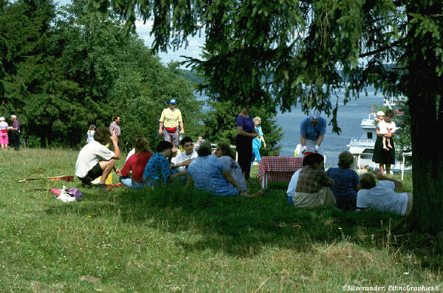
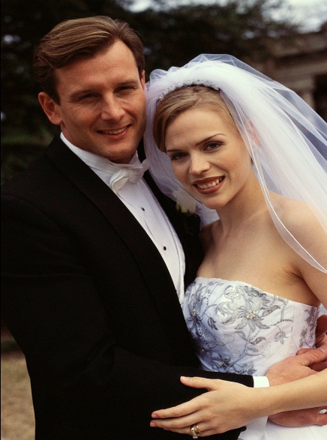

Tall Order when you see it like this!
Every stage that is “missed” leaves holes in someone’s life!
Notes:
Our maturity levels and the maturity of those we mentor will make a big difference how things go!
Yet if you check Scripture for the word “mature” or “maturity” it isn’t there in most translations!
How do we know this is a Scriptural way to proceed? In part, From the picture of the trees!

Slide 29
Men & Trees in Scripture
…that brings forth fruit in its season…
A tree brings forth fruit when it is mature! So does mankind!
Notes:
We wouldn’t expect a first year crop from a fruit tree, nor should we expect good fruit and wise counsel from someone who hasn’t yet matured. This does NOT automatically mean years! In fact, we often see that an immature “tree” or man has enough trouble trying to imagine what might be the right thing to do. We shouldn’t be surprised but rather “dig in” to find out where are the holes in the maturity process. This is true for both those who mentor, in doing self examination, as well as being aware of the maturity level of those we are asked to disciple and teach.

Slide 30
Wise Selection and Personal Preparation of Mentors is Essential!
A tree that hasn’t grown straight and firm isn’t strong enough to endure a storm.
A tree that doesn’t take in enough water won’t stand.
An unripe fruit doesn’t have the same food value as one that is ripe.
A soothing tongue is a tree of life,
But perversion in it crushes the spirit.
Proverbs 15:4 NASB
Notes:
Complete, Fullness, Perfection often used with connotation of maturity.
Pro 15:4 A soothing tongue is a tree of life, But perversion in it crushes the spirit.

Slide 31
Wise Selection and Personal Preparation of Mentors is Essential!
A tree that is straight and firm will remain even during struggle.
A well watered tree will have fruit to share.
A tree that draws from the Living Water will bring life to others.
The fruit of the righteous is a tree of life,
And he who is wise wins souls.
Proverbs 11:30 NASB
Notes:
Pro 11:30 The fruit of the righteous is a tree of life, And he who is wise wins souls.

Slide 32

And lest we think this is no longer important…
He who has an ear let him hear what the Spirit says to the churches; to him who overcomes I will grant the right to eat of the tree of life which is in the
paradise of God.
Revelation 2:7 NASB
Notes:
Our Messiah!! He is for the healing of the nations! He is coming again soon.
Questions on Life Model Portion?

Slide 33
Common Dysfunctional
Relationship Picture
Part 3
The Drama Triangle: Victim, Persecutor, Rescuer “Scripts”
Notes:
One of the indicators of immaturity is difficulty in maintaining stable relationships. Some people have never had the opportunity to develop trust with another person, nor do they know themselves and how to persevere to do the hard things. These “holes” leave opportunity for a predictable set of behaviors to develop; NOT the kind that we want to see grow! Falling away from the tree of life!

Slide 34

Discussion Group
Format
A model ‘script” of the most common roles or behaviors people fall into;
helpers and helpees!
Notes:
With thanks to Dr. Stephen Karpman who graciously gave his permission for us to use his model and develop it for community.
Bonus track of Janell Schroeder, of SAM, providing a review of the Stages of the Life Model.

Slide 35
Triangle Often Mistaken for Love
Chaotic relationships are often experienced as “normal” so people believe these behaviors equal what it means to love and be connected to someone.
Chaotic relationships are common but not normal!

Slide 36
Three Typical Roles
Victim
Cringing, pleading, helpless
Perpetrator
Angry, vindictive, blaming
Rescuer
Placating, make “nice,” fixing
Notes:
CAUTION: There is such a thing as a real victim! There is such a thing as someone offering genuine, appropriate help.
There is such a thing as someone expressing appropriate anger.
A simple and common mistake is to think that anyone who does these things appropriately is falling into the Drama Triangle script. The key is to look at the fruit of the behavior. The maturity of the people involved will also affect correct understanding.

Slide 37
Placement on the Triangle
Persecutor Rescuer
Victim
Notes:
Most people who fall into this pattern are especially good at one role; many switch back and forth between two; and there are also those who swing all the way around through all three.

Slide 38
Placement on the Triangle
Persecutor Rescuer
Victim
Notes:
Usually follows these pathways first…
Upper positions seen as more powerful; desirable.

Slide 39
Placement on the Triangle
Persecutor
Rescuer
Victim
Notes:
Usually temporary state of “closeness” is seen as a reward for persistence, and staying involved long enough to get there.
But the fall from grace is usually pretty hard; back to the other roles.

Slide 40
Placement on the Triangle
Persecutor Rescuer
Victim
Notes:
Out of temporary truce and back into usual chaos…. Love??? Relationship???

Slide 41
Ineffective Ways to Get Off Triangle
Be a Better Persecutor
Be a Better Rescuer
Be a Better Victim

Slide 42
Effective Way to Get Off Triangle: .
Personal Steps
Prayer
Personal Assessment and Honesty
Learn to Respond rather than React

Slide 43
Escape from the Triangle
Persecutor Rescuer
X
Self-Care
Victim
Notes:
End Goal is NOT to be flowing around the triangle anymore: but standing outside it in Prayerful Strength! Not being drawn into unwise counsel or behavior, but supplying wisdom, understanding and Truth!

Slide 44
The “Backward Learning Process”
1. Recognize that this has happened to me
in the past.
2. Recognize that this has happened to me
recently.
3. Recognize when this is happening
in the present!
4. Recognize when this is ABOUT to happen.
Notes:
Using wisdom and understanding about the Word and How we are designed will lead to giving wise counsel to those who are thirsty for the Truth. Recognizing the Drama Triangle at work will also help spot when the conversation is “stuck” or going off track to enable getting back to the focus on encouragement and exhorting to follow our Messiah, not matter what the circumstances or environment. Teaching this process to those we mentor gives a “frame of reference” they will be able to relate to. If they are serious about learning, they will receive the re-direction.

Slide 45
Trees fed by Living Water Bring Life!
What kind of Counsel do you receive and give?
Notes:
Exhortation and Encouragement Speaking FOR what is good and AGAINST what is bad!

Slide 46
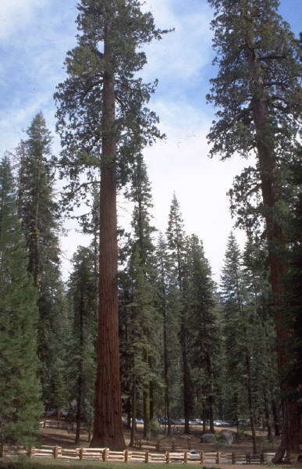
Wise and Firm?
Crooked and Barren?
Notes:
The maturity and “kind” of tree you are will determine what kind of “trees” you raise up in others.

Slide 47
Be Aware of Fear and Sabotage Issues
Drama Triangle behaviors have been defined as
“love” and caring relationships.
Stepping out of them leaves the other person “adrift” and uncertain.
Often try VERY hard to pull you back into it; not because they are “bad” but because they think it is what constitutes relationship!
Notes:
Even the best “trees” run into resistance! Most of our God’s children are rebellious.
The seven abominations of rebellion in our human spirits die hard. Don’t be surprised! Be Wise!
Remember Step 4! EXPECT IT! Recognize it and don’t fall into it!
If you later realize you did, go back and walk it through with the person as a teaching tool.

Slide 48

Trees planted by living water bring Life!
..
"For he will be like a tree planted by the water, That extends its roots by a stream And will not fear when the heat comes; But its leaves will be green, And it will not be anxious in a year of drought Nor cease to yield fruit.
Jeremiah 17:8 NASB
Notes:
Jail Ministry! An opportunity to stand as a straight and firm elder to bring life and to
water “thirsty” trees!

Slide 49
With grateful thanks to my teachers:
E. James Wilder, PhD; The Life Model
Shepherd’s House, Pasadena CA
Dr. Stephan Karpman; The Drama Triangle
Dr. Hollisa Alewine;The Creation Gospel & The Seven Abominations, London, KY
Set Apart Ministries Community; De Pere, Wisconsin
who encourage and challenge me in every way.
All Praise to the ever living God, Who Gives me Songs and Counsel in the night!

Slide 50
Thank you!
For more information please contact me at:
Barbara L. Klika, MSW, Personal Life Coach
Undershepherd Personal Life Coach
Set Apart Ministries, Inc. Still Waters, Inc. of Green Bay
P. O. Box 5584 P. O. Box 5734
De Pere, WI 54115 De Pere, WI 54115
www.christian-transitions.com
www.set-apart-ministries.org
info@set-apart-ministries.org
(920) 336-7005

